Slide 1
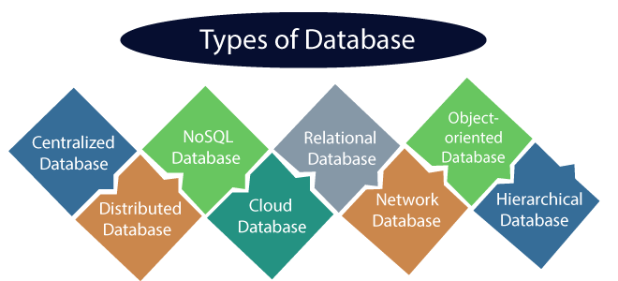

Slide 2
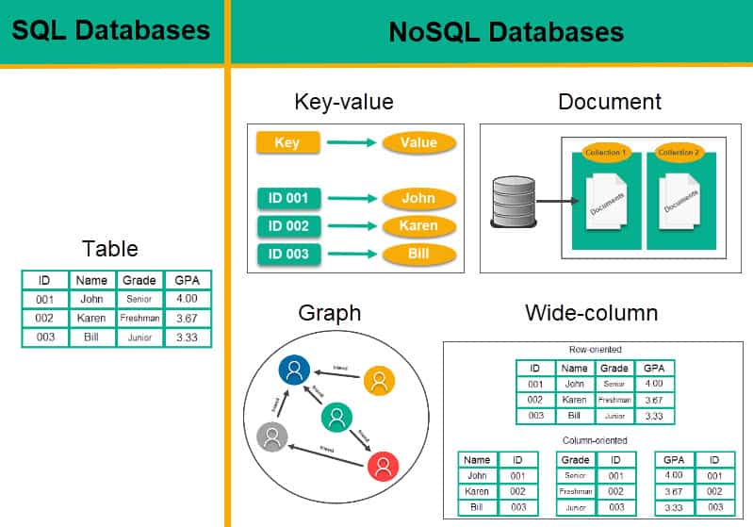

Slide 3
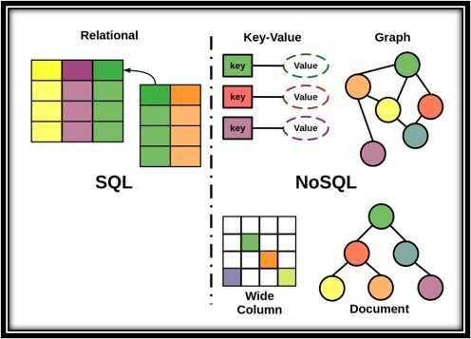

Slide 4
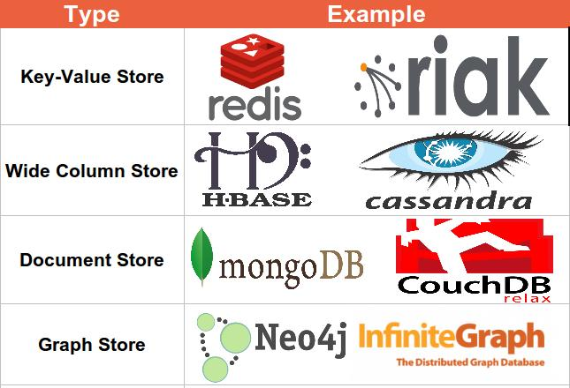

Slide 5
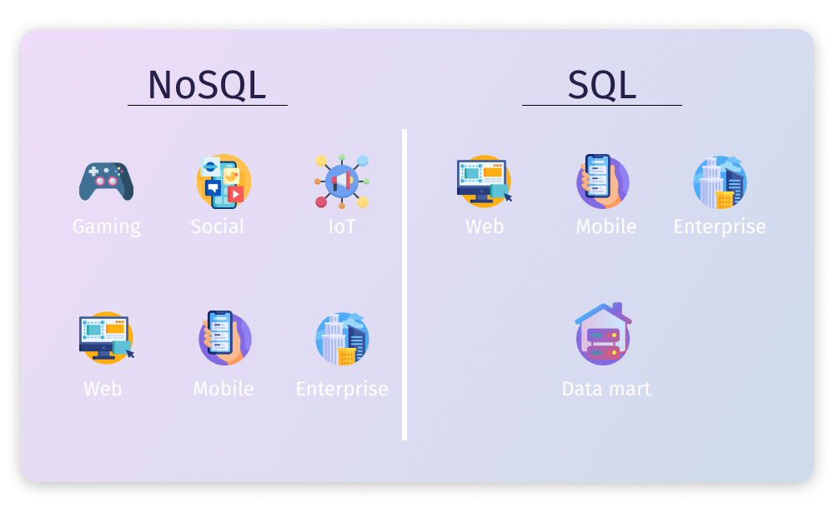

Slide 6
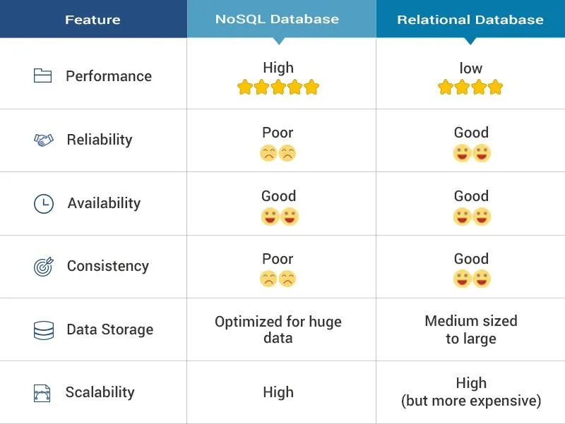

Slide 7
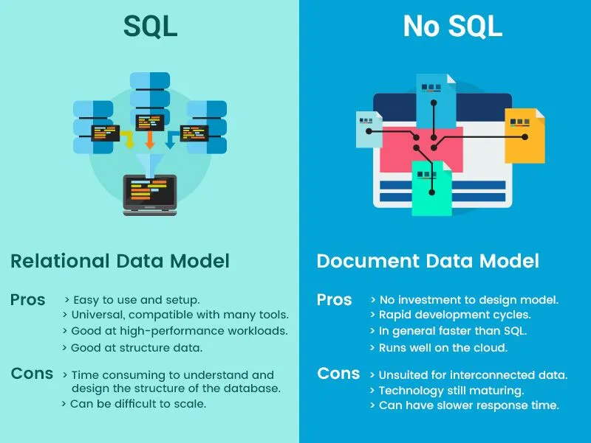

Slide 8


Slide 9
Who created MongoDB?
MongoDB was created by the founders of a company called 10gen, which was co-founded by Dwight Merriman, Eliot Horowitz, and Kevin Ryan.
The original development of MongoDB was largely led by Dwight Merriman (former CTO of DoubleClick) and Eliot Horowitz (software developer).
When was MongoDB created?
MongoDB was initially developed in 2007 and was released to the public in February 2009 as an open-source NoSQL database.

Slide 10
Why was MongoDB created?
The main motivation behind the creation of MongoDB came from the limitations the founders faced while working at DoubleClick, an online advertising company that needed to store and manage massive volumes of data with high availability and scalability. At the time, relational databases like MySQL and PostgreSQL, which were dominant, struggled to scale horizontally across many servers, making them less suited for handling large-scale web applications and distributed systems.
Version History:
https://www.mongodb.com/resources/products/mongodb-version-history
Latest Version as on 2024:
MongoDB 7.0 (current) | MongoDB 8.0 (upcoming)

Slide 11
Fortune 500 and Large Enterprises
Amazon: Utilizes MongoDB for certain services within its ecosystem.
Google: Uses MongoDB for specific services and internal tools.
Facebook: Employs MongoDB for internal data storage needs in some applications.
Adobe: Leverages MongoDB for storing and managing customer data.
Cisco: Uses MongoDB for managing enterprise-scale data.
eBay: Manages high-traffic databases using MongoDB for certain features.
SAP: Integrates MongoDB within its data management offerings.
Verizon: Uses MongoDB to manage customer data and high-availability applications.
AT&T: Relies on MongoDB for data storage in various services.
Technology and Software Companies
Uber: Uses MongoDB to store real-time ride data and other service-related data.
Lyft: Leverages MongoDB for managing user data and ride details.
LinkedIn: Implements MongoDB for features like activity streams and internal services.
Squarespace: Utilizes MongoDB for storing user content and website data.
HubSpot: Employs MongoDB for real-time data analysis and event tracking.
Coinbase: Uses MongoDB in its cryptocurrency trading platform.
Zendesk: Leverages MongoDB for ticket and customer data management.
Foursquare: Uses MongoDB to manage its geolocation-based services.
Craigslist: Migrated from MySQL to MongoDB for handling classified ad listings.
Intuit: Relies on MongoDB for some of its financial management tools.

Slide 12
Retail and E-commerce
Walmart: Uses MongoDB to handle online transactions, customer data, and scaling their e-commerce platform.
eBay: Uses MongoDB in different parts of its system, particularly for handling high-traffic areas.
Target: Employs MongoDB for scalability and customer engagement platforms.
Alibaba: Leverages MongoDB for data management and scaling its operations.
Media and Entertainment
The New York Times: Uses MongoDB to manage article metadata and real-time content updates.
Forbes: Uses MongoDB to handle content management and website interactions.
Sony: Employs MongoDB for storing and managing large volumes of media-related data.
MTV: Uses MongoDB to manage user engagement and media data.
Viacom: Leverages MongoDB for media asset management and real-time data analysis.
Financial Services
Barclays: Uses MongoDB for high-performance financial applications.
Goldman Sachs: Employs MongoDB in some of its analytics and risk management tools.
Citibank: Leverages MongoDB for various internal applications.
HSBC: Uses MongoDB to manage financial data.
Capital One: Relies on MongoDB for some customer data services.

Slide 13
Healthcare and Life Sciences
Medtronic: Uses MongoDB to manage data from medical devices.
AstraZeneca: Leverages MongoDB for managing research and patient data.
Philips Healthcare: Uses MongoDB in managing healthcare systems and patient data.
Epic: Employs MongoDB for healthcare data management and patient care systems.
Startups and Fast-Growing Companies
Tinder: Uses MongoDB for managing real-time chat and user matching services.
Slack: Leverages MongoDB for storing real-time messaging data.
Shutterfly: Uses MongoDB for managing customer photos and metadata.
Viber: Employs MongoDB for managing its messaging platform and real-time data.
Government and Nonprofits
UK Government Digital Service (GDS): Uses MongoDB for managing citizen data and government services.
The U.S. Government: MongoDB is used in various departments for scalability and real-time data handling.

Slide 14
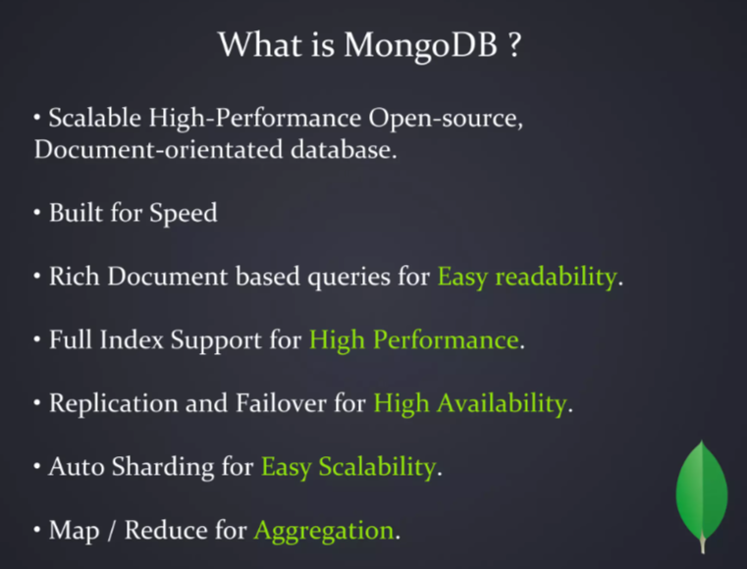

Slide 15
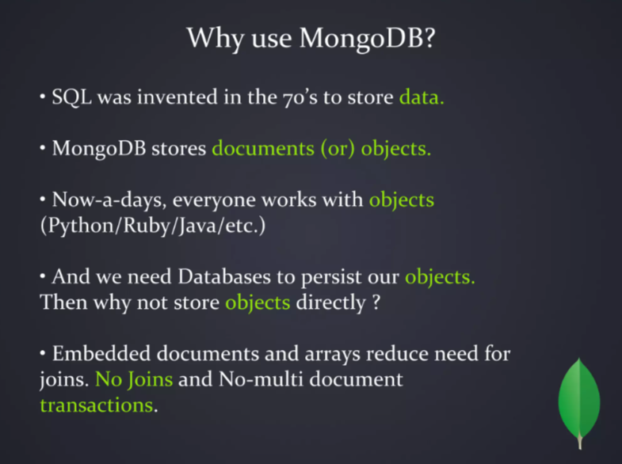

Slide 16
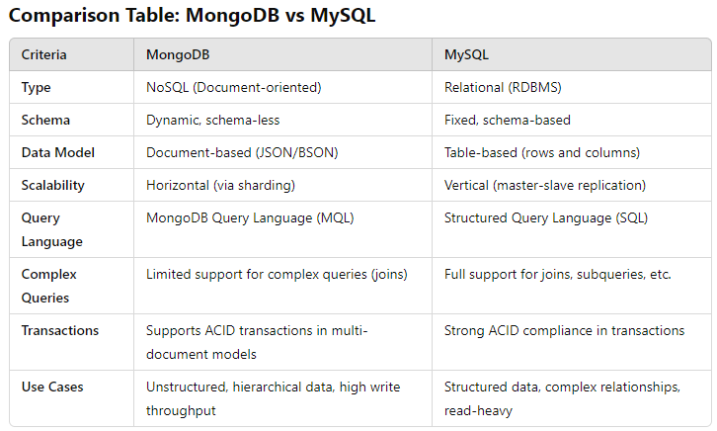

Slide 17
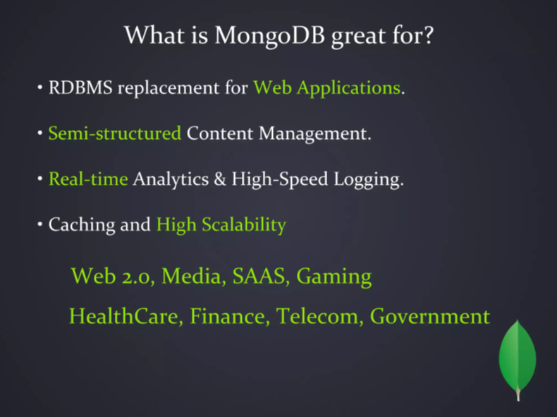

Slide 18
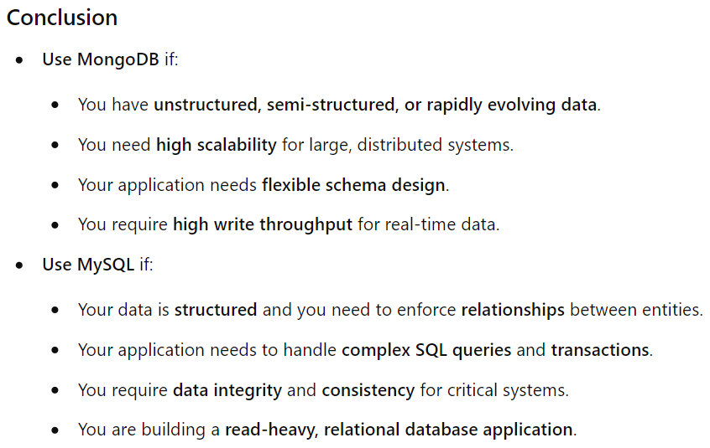

Slide 19
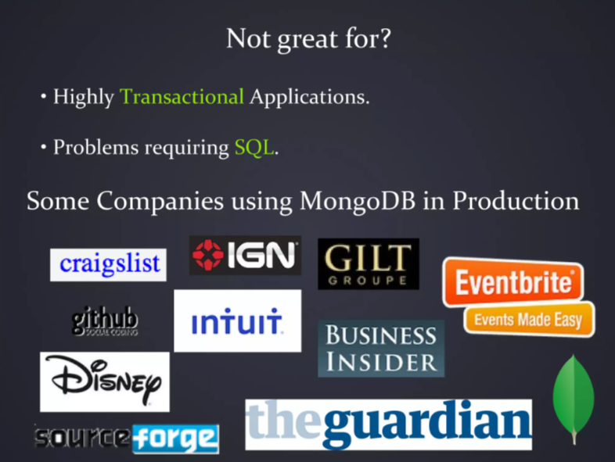

Slide 20
1. Facebook (Messenger)
Use Case: Messenger, Facebook's messaging platform, uses MongoDB to store billions of messages and provide real-time, efficient message delivery.
2. Uber
Use Case: Uber uses MongoDB to store and manage real-time data about rides, drivers, and users. Its distributed architecture and scalability help Uber manage fast-growing global operations.
3. eBay
Use Case: eBay uses MongoDB for search and metadata storage. It helps the platform efficiently manage product information and provide fast search experiences to its users.
4. Twitter
Use Case: Twitter uses MongoDB to store social data, including user details, messages, and other real-time information. The platform benefits from MongoDB’s high scalability for managing dynamic content.
5. Coinbase
Use Case: The cryptocurrency exchange platform uses MongoDB for storing information related to users, transactions, and wallets. It helps manage large datasets while scaling with their rapidly growing user base.

Slide 21
6. LinkedIn
Use Case: LinkedIn uses MongoDB for certain parts of its infrastructure, especially in dealing with real-time analytics and feed data.
7. Pinterest
Use Case: Pinterest uses MongoDB for managing its large, unstructured datasets, including pins, boards, and user information.
8. Slack
Use Case: Slack uses MongoDB to manage user data, channel information, and message history for its communication and collaboration platform.
9. Zendesk
Use Case: Zendesk uses MongoDB to manage customer service data and helpdesk tickets, supporting high-traffic, multi-tenant architectures with real-time analytics.
10. Spotify
Use Case: The music streaming service uses MongoDB to store and manage a variety of datasets, including user profiles, playlists, and track information, ensuring quick retrieval and smooth user experiences.
11. Bosch
Use Case: Bosch leverages MongoDB in its IoT solutions, storing sensor data and managing connected devices in real-time.

Slide 22


Slide 23
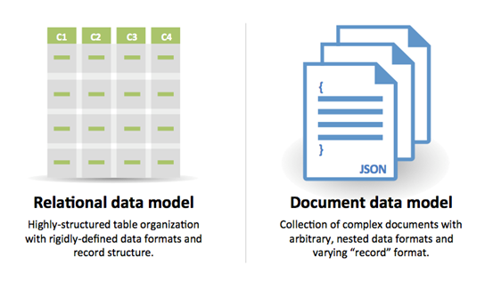

Slide 24
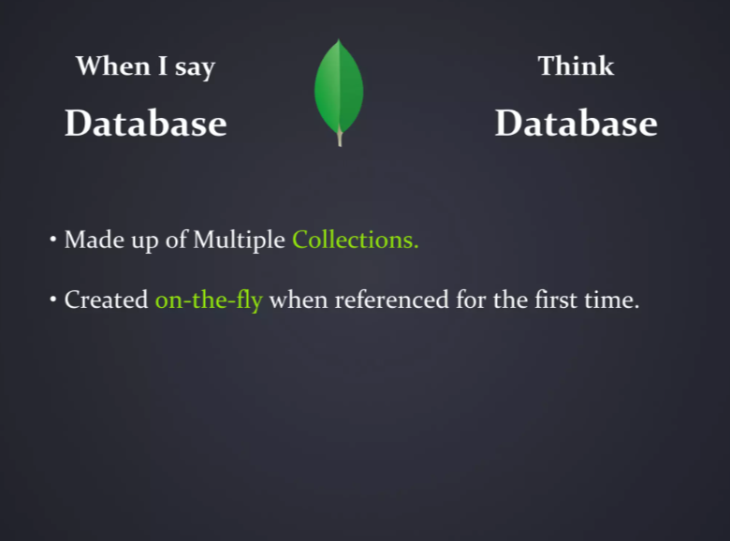

Slide 25
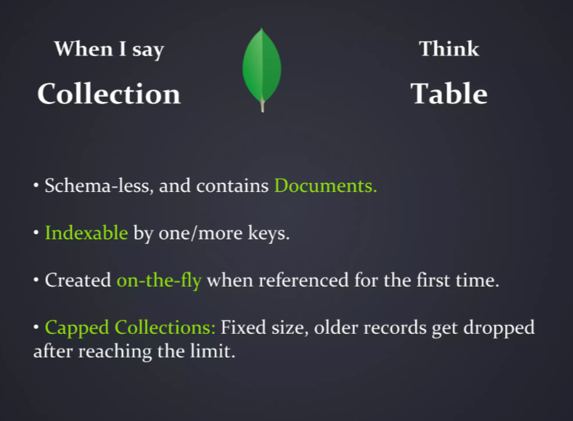

Slide 26
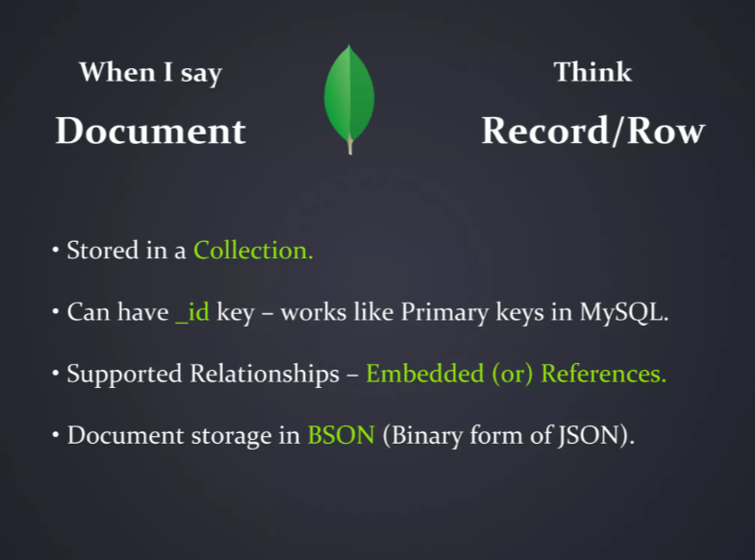

Slide 27
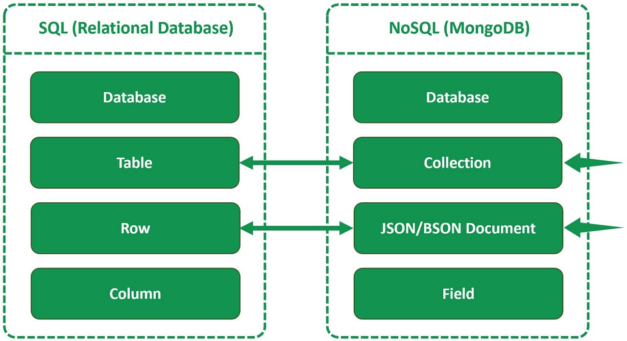

Slide 28
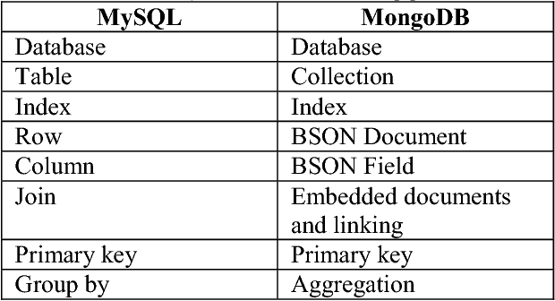

Slide 29
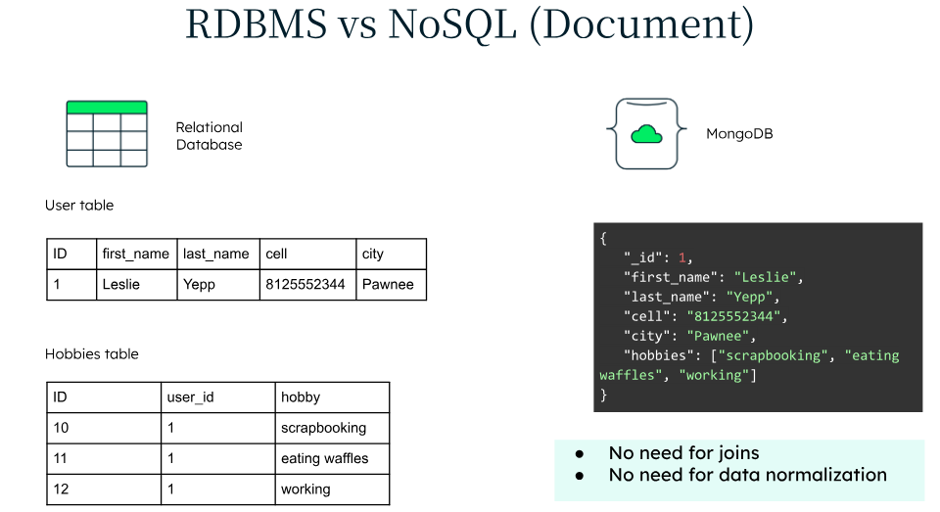

Slide 30
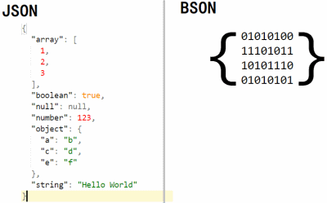
JAVASCRIPT OBJECT NOTATION BINARY JSON

Slide 31
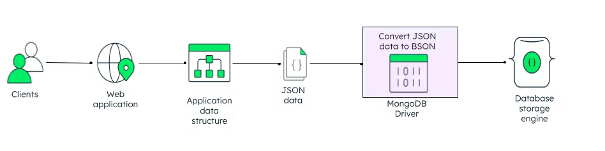
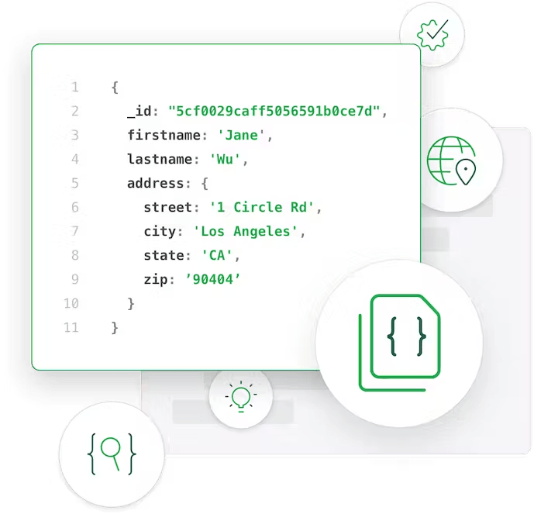

Slide 32
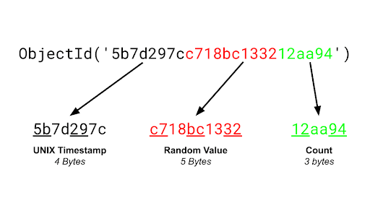

Slide 33
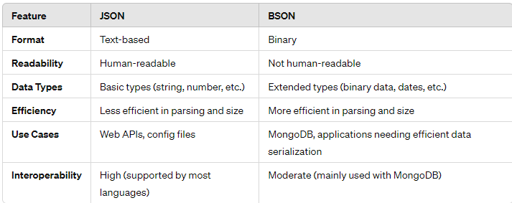

Slide 34
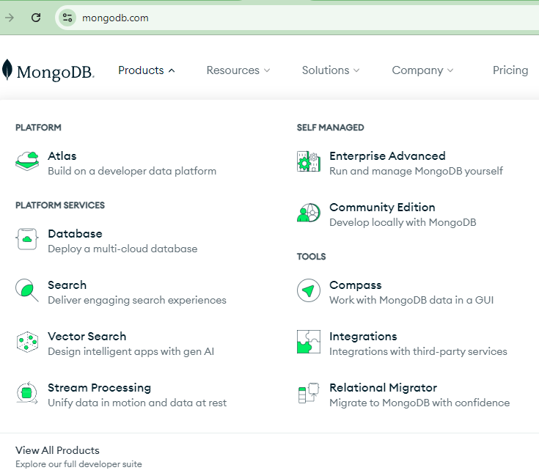

Slide 35
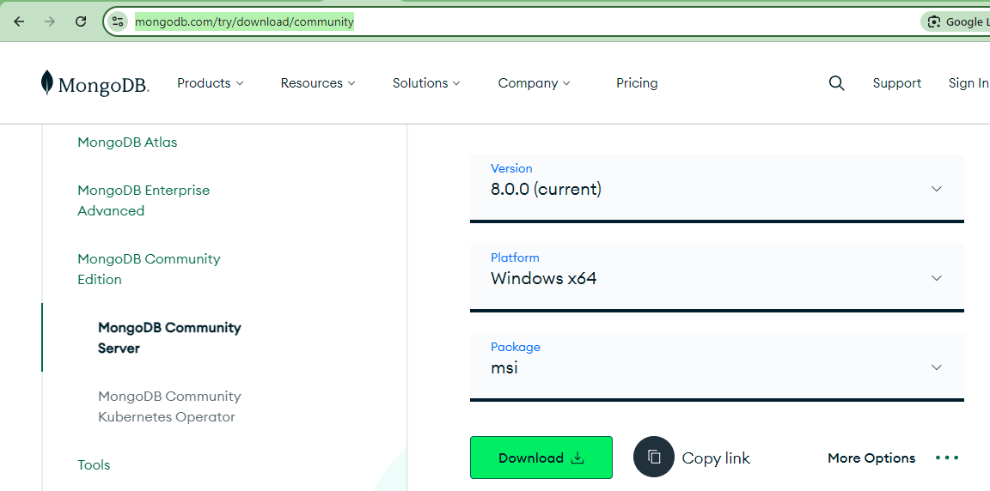
MongoDB Official Site: https://www.mongodb.com/
MongoD Server - Connect to MongoDB Remotely and Locally.
https://www.mongodb.com/try/download/community

Slide 36
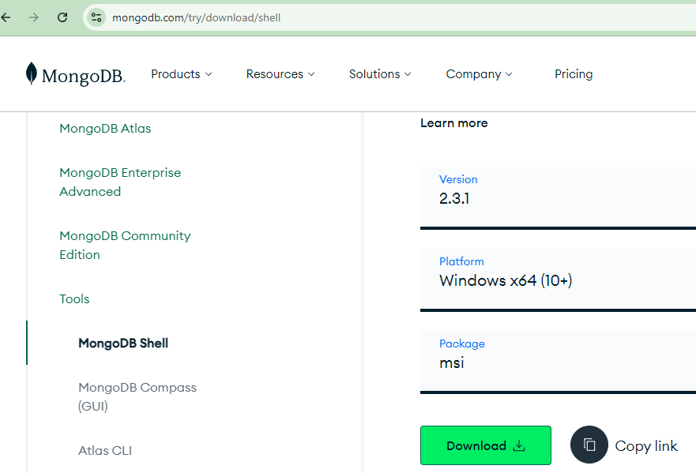
MongoSh - Shell used to write and run MongoDB Commands
https://www.mongodb.com/try/download/shell

Slide 37
test is empty default collection available with mongodb
1. db;
show current database name
2. show dbs;
lists the database available inside the computer except empty database like test, store
3. show collections;
lists the collections name inside the current db
4. use local;
switches from test db to local db
5. use store;
searches if there is a store db, if thats not available then it creates store db and switches to the store db
6. db.dropDatabase();
deletes the database in which we are currently working

Slide 38
Database - Company
Collections(Tables) - Products, Customers, Employees
3 ways to create a collection:
1. db.createCollection("Products");
2. db.createCollection("Employees",{capped:true,autoIndexId:true,size:673682683,max:100})
capped: if we want to set size for each document in the collection -> true
size: give the size of each document in bytes
autoIndexId: _id - like name, age, gender (has a random value - datatype ObjectId - unique parameter which identifies the document)
max - how many documents can this collection hold
3. db.Customers.insertOne({name:"John",age:30,gender:"male"});

Slide 39
SHOW ALL DOCUMENTS INSIDE A COLLECTION:
db.Customers.find();
DELETE PARTICULAR COLLECTION INSIDE A DATABASE:
db.Employees.drop();
DELETE ENTIRE DATABASE FROM MONGODB:
db.dropDatabase();
KNOW THE STATISTICS OF THE DATABASE
Store> db.stats();

Slide 40
INSERT DOCUMENT - 4 WAYS
1. db.Customers.insertOne({name:"Ahan",age:24});
2. db.Customers.insertMany([{name:"Ahan",age:25},{name:"Brinda",age:25},{name:"Cathy",age:26}]);
3. db.Customers.insert({name:"Dev",age:27});
4. db.Customers.insert([{name:"Elango",age:28},{name:"Fahad",age:29}]);
db.Customers.find();
FETCH DOCUMENTS - 3 WAYS
1. db.Customers.find(); --->all docs
2. db.Customers.findOne(); ---> first doc alone
3. db.Customers.findOne({name:"Dravya"});
4. db.Customers.find({age:20},{name:false}); --> hides name, shows _id, shows age:20
5. db.Customers.findOne({age:22},{_id:false}); --> shows name,age, hides _id
6. db.Customers.findOne({age:22}); --> first person whose age is 22(all details)

Slide 41
UPDATE DOCUMENTS - 2 ways
1. db.Customers.updateOne({name:"Maya"},{$set:{name:"Maya 2",age:44}}); -
--> finds all documents with name maya and changes the first maya doc ->name to maya 2 and age to 44
2. db.Customers.updateMany({age:20},{$set:{isMarried:false}});
--> finds all doc with age 20 and adds a new field to it
3. db.Customers.updateMany({},{$set:{gender:"unknown"}});
--> picks all doc and adds gender field to it
4. db.Customers.updateOne({_id:ObjectId("655cc608aaef34a37b3cec09"), name:"Maya2"} ,{$set:{gender:"Female"}});
DONT UPDATE _ID PROPERTY ->ERROR!

Slide 42
DELETE DOCUMENTS - 3 WAYS
db.Customers.deleteOne({});
--> deletes first doc
db.Customers.deleteMany({});
--->deletes all documents
db.Customers.deleteOne({name:"Dravya"});
db.Customers.deleteMany({age:22});
db.Customers.remove({gender:"unknown"});
--->removes all doc with gender unknown remove only first occuring gender:unknown alone to be deleted
db.Customers.remove({gender:"unknown"},false);
--->removes all doc with gender unknown
db.Customers.remove({gender:"unknown"},true);
-- > removes first occuring doc with gender:unknown
db.Customers.deleteMany({}); --->deletes all documents
db.Customers.remove({}); -->remove all docs

Slide 43
CURSORS: pointers to find list of all docs not as a batch but as an entire list.
find() -> WILL NOT RETURN ALL THE DOCS IN ONE GO..
db.Employees.insertMany([
{ firstName: "John", lastName: "Doe", age: 30, gender: "Male", salary: 50000, dept: "HR", city: "New York" },
{ firstName: "Jane", lastName: "Smith", age: 25, gender: "Female", salary: 55000, dept: "Finance", city: "Chicago" },
{ firstName: "Michael", lastName: "Johnson", age: 35, gender: "Male", salary: 60000, dept: "IT", city: "San Francisco" },
{ firstName: "Emily", lastName: "Davis", age: 28, gender: "Female", salary: 52000, dept: "Marketing", city: "Los Angeles" },
{ firstName: "William", lastName: "Brown", age: 40, gender: "Male", salary: 70000, dept: "Sales", city: "Seattle" },
{ firstName: "Jessica", lastName: "Wilson", age: 32, gender: "Female", salary: 58000, dept: "HR", city: "Boston" },
{ firstName: "David", lastName: "Martinez", age: 29, gender: "Male", salary: 65000, dept: "Finance", city: "Houston" },
{ firstName: "Sarah", lastName: "Anderson", age: 27, gender: "Female", salary: 54000, dept: "IT", city: "Phoenix" },
{ firstName: "Christopher", lastName: "Taylor", age: 38, gender: "Male", salary: 62000, dept: "Marketing", city: "Denver" },
{ firstName: "Karen", lastName: "Thomas", age: 31, gender: "Female", salary: 59000, dept: "Sales", city: "Miami" },
{ firstName: "Joshua", lastName: "Moore", age: 33, gender: "Male", salary: 53000, dept: "HR", city: "Atlanta" },
{ firstName: "Laura", lastName: "Jackson", age: 26, gender: "Female", salary: 57000, dept: "Finance", city: "Dallas" },
{ firstName: "Matthew", lastName: "White", age: 37, gender: "Male", salary: 61000, dept: "IT", city: "San Diego" },
{ firstName: "Ashley", lastName: "Harris", age: 24, gender: "Female", salary: 51000, dept: "Marketing", city: "Philadelphia" },
{ firstName: "James", lastName: "Martin", age: 41, gender: "Male", salary: 68000, dept: "Sales", city: "Las Vegas" },
{ firstName: "Amanda", lastName: "Thompson", age: 34, gender: "Female", salary: 56000, dept: "HR", city: "San Antonio" },
{ firstName: "Brian", lastName: "Garcia", age: 36, gender: "Male", salary: 63000, dept: "Finance", city: "Orlando" },
{ firstName: "Nicole", lastName: "Martinez", age: 29, gender: "Female", salary: 52000, dept: "IT", city: "Portland" },
{ firstName: "Steven", lastName: "Martinez", age: 39, gender: "Male", salary: 65000, dept: "Marketing", city: "Austin" },
{ firstName: "Megan", lastName: "Lee", age: 30, gender: "Female", salary: 59000, dept: "Sales", city: "Charlotte" },
{ firstName: "Shilton", lastName: "Holmes", age: 31, gender: "Male", salary: 56000, dept: "IT", city: "Orlando" }
]);

Slide 44
CURSORS:
toArray()
forEach()
db.Employees.find();
WE NEED TO TYPE “IT” TO FETCH THE NEXT BATCH OF DATA
db.Employees.find().toArray();
find-> 20 docs ->to array will request for the next batch automatically. No need to press IT here
db.Employees.find().forEach(function(employees){print("Name: "+employees.name+" Age: "+employee.age)});

Slide 45
CRUD WITH ARRAYS
db.Customer.insert(
[{name:"Naga",age:27,hobbies:["eat","sleep","code"]},
{name:"Muthu",age:28,hobbies:["eat","sleep"]},
{name:"Lakshmi",age:29,hobbies:["code","play"]},
{name:"Suji",age:22,hobbies:["sleep","play","run"]}
]);
db.Customer.find({hobbies:"run"});
db.Customer.find({"hobbies.0":"sleep"})
db.Customer.updateOne({name:'Muthu'},{$set:{"hobbies.0":"drink"}});
db.Customer.updateOne({name:'Muthu'},{$set:{"hobbies.2":"jog"}});
db.Customer.updateOne({name:'Muthu'},{$push:{"hobbies":"draw"}});
db.Customer.updateOne({name:'Muthu'},{$pop:{"hobbies":1}});
db.Customer.updateOne({name:'Muthu'},{$pop:{"hobbies":-1}});
db.Customer.updateOne({name:'Muthu'},{$pull:{"hobbies":"sleep"}});
db.Customer.update( {name:'Muthu'}, { $push: { hobbies: { $each: ['sleep'], $position: 2 } } } )
push - will add the data at the end of the array, push cant add data to a specific position
pop - remove data at the start (-1)or at the end(1)
pull - remove many matches found in the array irrespective of the position

Slide 46
EMBEDDED DOCUMENTS - OBJECTS
use Company
Create Products Collection
Insert a sample document into the Products collection.
db.Products.insertOne({
productId: 1,
name: "Laptop",
price: 1500,
specifications: {
brand: "Brand A",
model: "A123",
processor: "Intel i7",
RAM: "16GB",
storage: "512GB SSD"
},
reviews: [
{user: "JohnDoe",rating: 4,comment: "Great performance"},
{user: "JaneSmith", rating: 5, comment: "Excellent build quality"}]
})

Slide 47
db.Products.insertOne({
productId: 2,
name: "Smartphone",
price: 800,
specifications: {
brand: "Brand B",
model: "B456",
processor: "Snapdragon 888",
RAM: "8GB",
storage: "128GB"
},
reviews: [
{
user: "Alice",
rating: 4,
comment: "Good value for money"
},
{
user: "Bob",
rating: 3,
comment: "Average battery life"
}
]});

Slide 48
Find all products.
db.Products.find()
Find a product by productId.
db.Products.find({ productId: 1 })
Find products with a price less than $1000.
db.Products.find({ price: { $lt: 1000 } })
Find products with a specific specification.
db.Products.find({ "specifications.brand": "Brand A" })
Find products with a specific review rating.
db.Products.find({ "reviews.rating": 5 })
Update: Modify Documents
Update the price of a product.
db.Products.updateOne(
{ productId: 1 },
{ $set: { price: 1400 } }
)
Add a new review to a product.
db.Products.updateOne(
{ productId: 1 },
{ $push: { reviews: { user: "NewUser", rating: 4, comment: "Good laptop" } } }
)
Update a specific review in a product.
db.Products.updateOne(
{ productId: 2, "reviews.user": "Alice" },
{ $set: { "reviews.$.comment": "Excellent value for money" } }
)
Update multiple documents.
db.Products.updateMany(
{ "specifications.brand": "Brand B" },
{ $set: { price: 850 } }
)
Delete: Remove Documents
Delete a product by productId.
db.Products.deleteOne({ productId: 2 })

Slide 49
Delete products with a specific specification.
db.Products.deleteMany({ "specifications.brand": "Brand A" })
Delete a specific review from a product.
db.Products.updateOne(
{ productId: 1 },
{ $pull: { reviews: { user: "JohnDoe" } } }
)
Update: JohnDoe's Rating
db.Products.update({"reviews.user":"JohnDoe"},{$set:{"reviews.0.rating":4.9}});

Slide 50
PROJECTIONS:
find(),sort(),limit(),0/1,skip
//hide only _id, allowed to give 0 to _id property alone
db.Employees.find({},{_id:0,firstname:1,lastname:1,age:1,languages:1});
MongoServerError: Cannot do exclusion on field languages in inclusion projection--> Exclusively we cant set 0 for the fields except _id.
If you dont want to view that field, better not to mention it
If you dont want to retrieve _id-> mention 0, if we have not included _id in the command or if we keep _id:1 -> it will be always retrieved.
Sort -> asc, dec
db.Employees.find().sort({firstname:1}); //ascending order of names
db.Employees.find().sort({lastname:-1}); //decending order of names
db.Employees.find().sort({age:-1});

Slide 51
limit -> retrieve first range of fields, based on insersion order - retrieve first 3 records/5 record
1,2,3,4,5,6,7,8,9
db.Employees.find().limit(5);
1,2,3,4,5
Skip-> retrieve the balance records leaving first range of records, based on insersion order - leave first 3 records and retrieve the balance
1,2,3,4,5,6,7,8,9
db.Employees.find().skip(3);
4,5,6,7,8,9
retrieve the 3rd to 7th document based on insersion order
1,2,3,4
db.Employees.find().skip(2).limit(5);

Slide 52
AGGREGATION
- FRAMEWORK OF MONGODB FOR COMPLEX QUERIES
Retrieve the persons whose age is 18
var pipeline = [{$match:{age:18}}];
db.Employees.aggregate(pipeline);
$group - retrieve group of documents based on group of conditions
-> sum of ages:
var pipe1 = [{$group:{_id:"P123",totalAges:{$sum:"$age"}}}];
db.Employees.aggregate(pipe1);
-> min, max,avg age for all the employees:
var pipe2 = [{$group:{_id:"P123",totalAges:{$sum:"$age"}, maxAge:{$max:"$age"}, minAge:{$min:"$age"}, avgAge:{$avg:"$age"},}}];
db.Employees.aggregate(pipe2);

Slide 53
-> Find the group of people who has the same age----> {$sum:1}
var pipe3 = [{$group:{_id:"$age",countAge: {$sum:1}}}];
db.Employees.aggregate(pipe3);
$match -> finds the document with required detail
-> Find the students who knows c language:
var pipe4 = [{$match:{"languages":"c"}}];
db.Employees.aggregate(pipe4);
lastname ends with c- case insensitive
var pipe 11 = [{$match:{"lastname":/c$/i}}];
db.Employees.aggregate(pipe11);
lastname starts with c- case insensitive
var pipe 11 = [{$match:{"lastname":/^c/i}}];
db.Employees.aggregate(pipe11);
lastname ends with c- case sensitive
var pipe 11 = [{$match:{"lastname":/c$/}}];
db.Employees.aggregate(pipe12);

Slide 54
lastname contain e - case sensitive
var pipe 11 = [{$match:{"lastname":/e/i}}];
db.Employees.aggregate(pipe12);
$limit -> how many number of documents you want based on the search (shows result starting from first)
First member of 18 years age:
var pipe5 = [{$match:{"age":18}},{$limit:1}];
db.Employees.aggregate(pipe5);
$gt, $lt -> greater than, lesser than
db.Employees.find({age:{$lte:19}});
db.Employees.find({age:{$gte:20}});
$skip ->how many number of documents you want to leave based on the search (shows result starting from first)
find the people with 18 years excluding first 2 members
var pipe6 = [{$match:{"age":18}},{$skip:2}];
db.Employees.aggregate(pipe6);
//A,D will be skippped, a1,d1 will be printed
find the third member who has 18 years of age:
var pipe6 = [{$match:{"age":18}},{$skip:2},{$limit:1}];
db.Employees.aggregate(pipe6);

Slide 55
$lte - Lesser than and Equal to
var pipe7 =[{$match:{age:{$lte:19}}}];
db.Employees.aggregate(pipe7);
$gte - Greater than and Equal to
var pipe8 =[{$match:{age:{$gte:19}}}];
db.Employees.aggregate(pipe8);
Find the persons of age in between 30 to 48
Company> var pipe9=[{$match:{age:{$lte:48}}},{$match:{age:{$gte:30}}}];
Company> db.Persons.aggregate(pipe9);

Slide 56
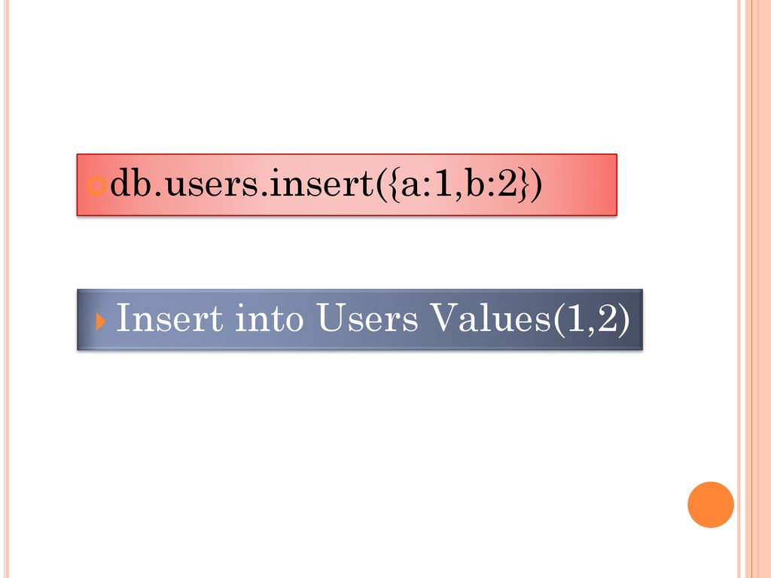
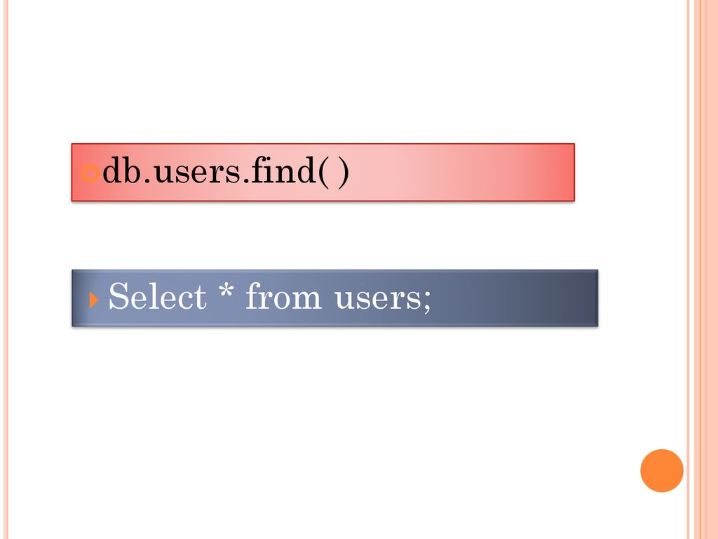

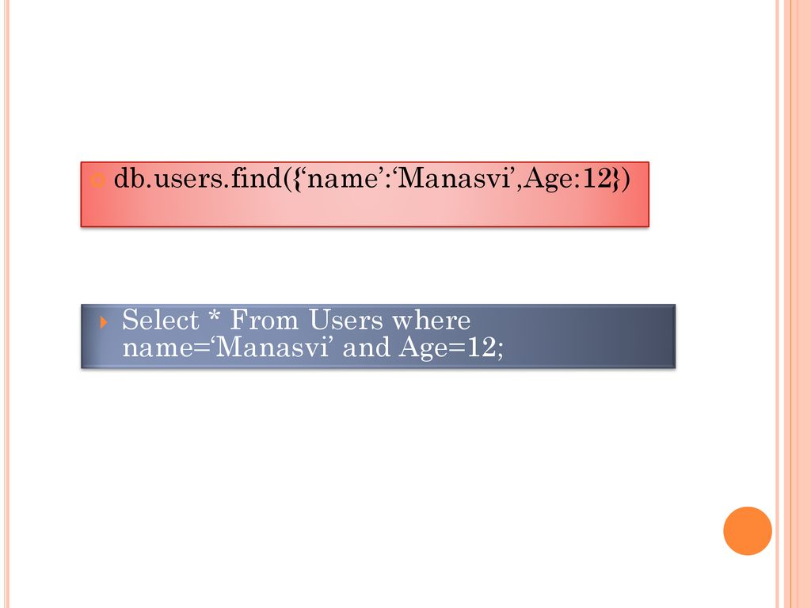
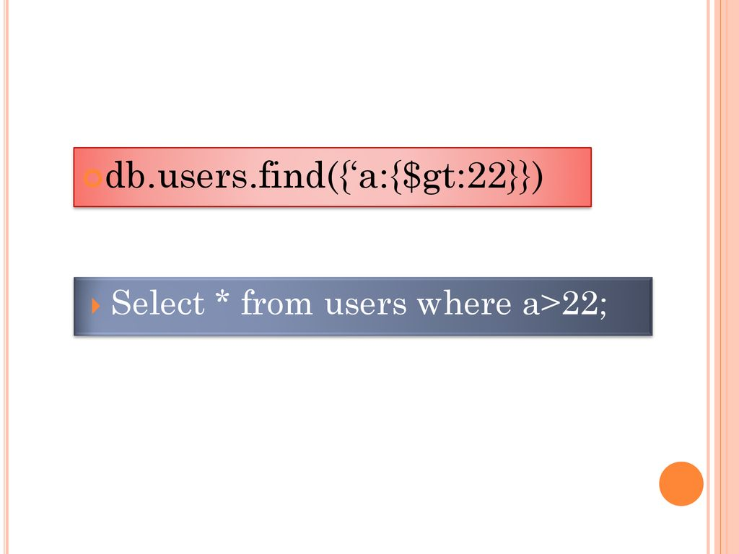


Slide 57
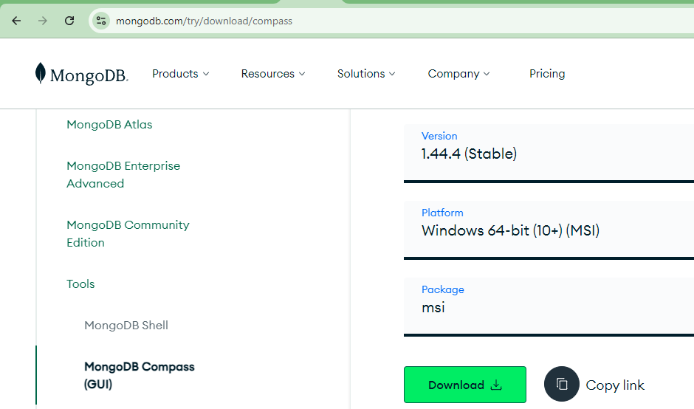
MongoDB Compass - User Interface tool like Workbench-MYSQL to view and operate local and remote Databases.
https://www.mongodb.com/try/download/compass

Slide 58
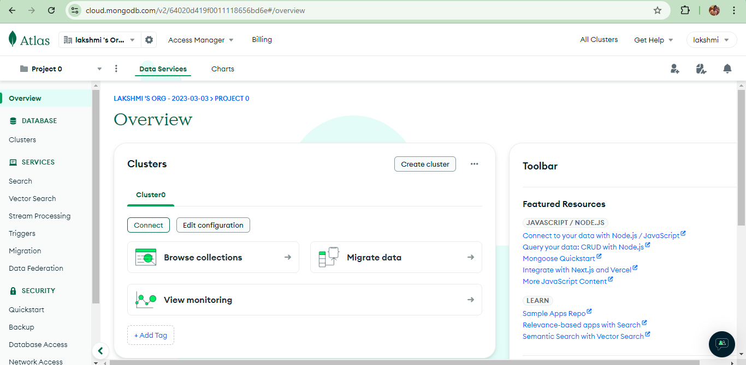
MongoDB Atlas - Platform to create and store remote databases. Gives lot of provision to do CRUD operations, and used to connect with JAVA, Python, Php servers.
https://www.mongodb.com/atlas

Slide 59
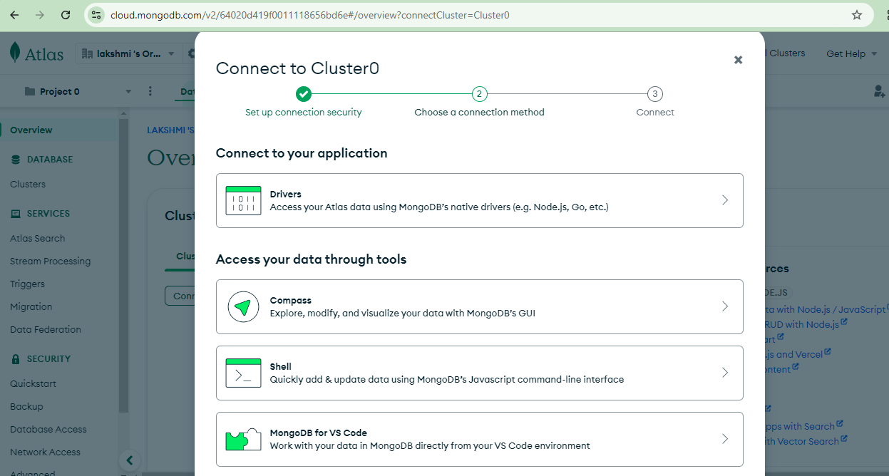

Slide 60
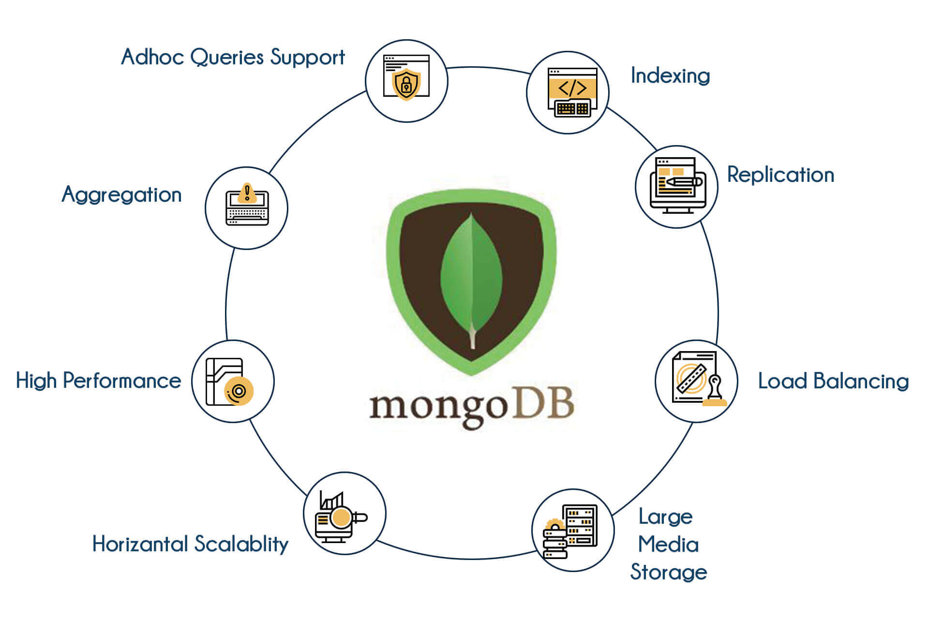

Slide 61
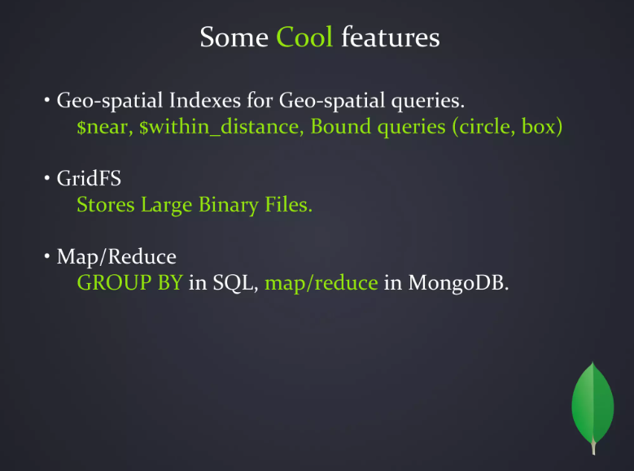

Slide 62


